Slide 1
Intermediacy of publications
Lovro Šubelj¹, Ludo Waltman², Vincent Traag², and Nees Jan van Eck²
¹Faculty of Computer and Information Science, University of Ljubljana, Ljubljana, Slovenia
²Centre for Science and Technology Studies, Leiden University, Leiden, The Netherlands
17th International Conference on Scientometrics & Informetrics
Rome, Italy, September 4, 2019

Slide 2
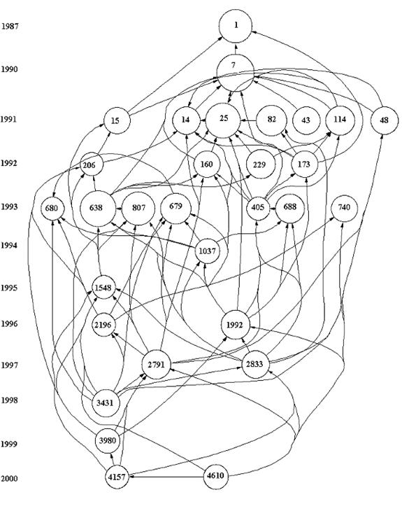
Introduction
Citation networks offer insights into the development of science
Historiography: tracing the development of a scientific field
What publications have been important in that development?
We propose a new measure called intermediacy

Slide 3
Existing approaches
Main path analysis
Relies on traversal counts of citation links
Selects citation path(s) that have a high sum of traversal counts
Rewards relatively long paths
Conceptually unclear, not always clear results
Shortest or longest paths
Shortest paths typically do not include most important publications
Longest paths typically include many irrelevant publications

Slide 4
Main idea of intermediacy
Given a citation network with a source (s) and a target (t) publication
Intermediacy relies on citation links to identify important intermediate publications
Important intermediate publications should be well connected
The more important the role of a publication in connecting source s to target t, the higher the intermediacy of that publication

Slide 5
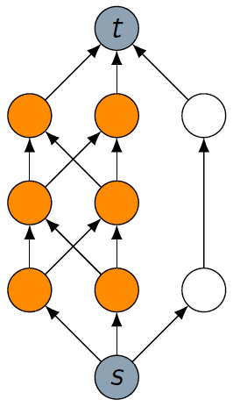
Illustration
Only some citations are active
Each citation is active with probability p
Is there a path (of active citations) through a publication?

Slide 6
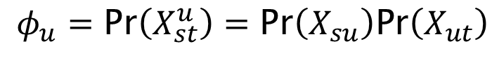
Formal notation
Each citation is active with probability p
Intermediacy is the probability publication u lies on a path from s to t
Intermediacy of publication u from s to t is
Pr(X_{ij}) is the probability there is a path from i to j
$$φ_{u}=\text{Pr}\left(X_{st}^{u}\right)=\text{Pr}\left(X_{su}\right)\text{Pr}\left(X_{ut}\right)$$

Slide 7
How does intermediacy behave?
For p→0 shortest paths are most important
For p→1 number of independent paths are most important

Slide 8
Properties of intermediacy
Path addition and contraction increase intermediacy
Intuition: path from source to target becomes “easier”

Slide 9
Comparison with alternative approaches
Alternative approaches violate path contraction property

Slide 10
Exact algorithm
Decomposition algorithm by edge contraction and removal
Runs in exponential time (NP hard)

Slide 11
Approximate algorithm
Simple Monte Carlo simulation algorithm by sampling
Runs in linear time using probabilistic depth-first search

Slide 12
Use case: community detection in scientometrics
Source: Klavans & Boyack (2017), Which type of citation analysis generates the most accurate taxonomy of scientific and technical Knowledge?, JASIST, 68(4), 984-998.
Target: Newman & Girvan (2004), Finding and evaluating community structure in networks, Phys. Rev. E, 69(2), 026113.

Slide 13
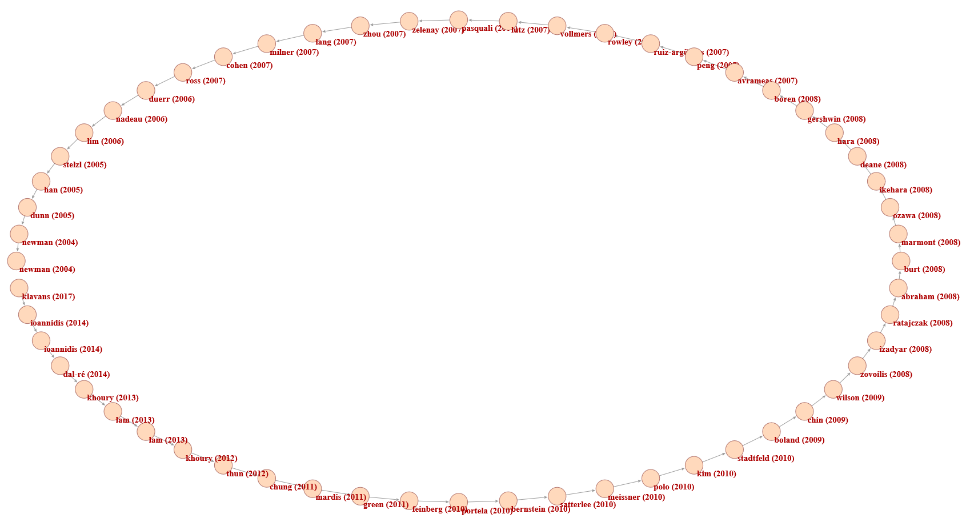
Standard global main path (Pajek)

Slide 14
Conclusions
Intermediacy as a new measure of importance of publications
Conceptually clear and provable behavior in extreme cases
Favors short paths and many independent paths
Shows promising results in case studies
Future work:
Implementation in tool
Applicability to other types of networks

Slide 15
Thank you for your attention!

Slide 16
Questions?
Paper available on arXiv: arxiv.org/abs/1812.08259
Code available on GitHub: github.com/lovre/intermediacy
Lovro Šubelj
University of Ljubljana lovro.subelj@fri.uni-lj.si http://lovro.lpt.fri.uni-lj.si
Vincent Traag
Leiden University v.a.traag@cwts.leidenuniv.nl www.traag.net
Ludo Waltman
Leiden University waltmanlr@cwts.leidenuniv.n www.ludowaltman.nl
Nees Jan van Eck
Leiden University ecknjpvan@cwts.leidenuniv.n www.neesjanvaneck.nl

